Slide 1
Twitter Sentiment & Stock Price Correlation
Presented by: The Forecasters
Georgetown University Data Science Certificate
Fall 2015
Max Almodovar
Jonathan Creem
Andrew Miller
Caroline Morris

Slide 2
Problem & Hypotheses

Slide 3
To Better Illustrate the Problem…
A Wolf of Wall Street scene...
https://www.youtube.com/watch?v=4GA8MQGvr_U
A scene from Margin Call..
https://www.youtube.com/watch?v=UOYi4NzxlhE

Slide 4
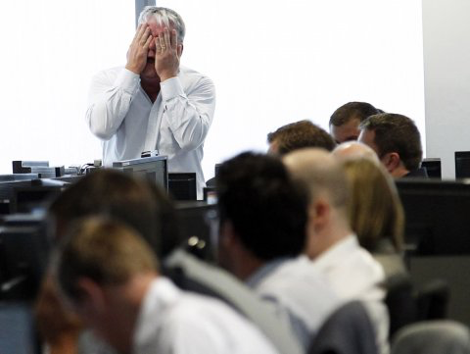
The Real Issue
Rise of big data presents the opportunity to incorporate analytics into forecasting models
THE STRUGGLE IS REAL for forecasters to accurately predict the stock market using Big Data. Its new, and many, just don’t know how.
Our model can help….!

Slide 5
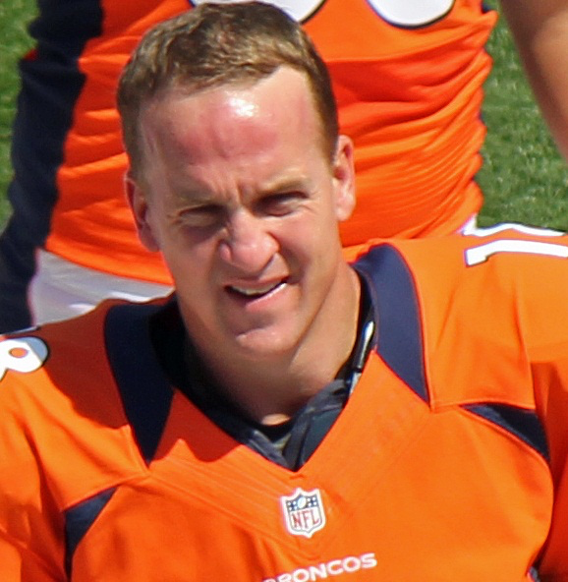
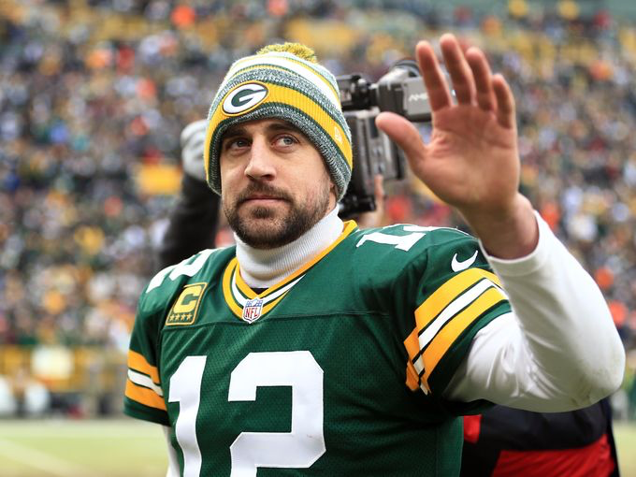
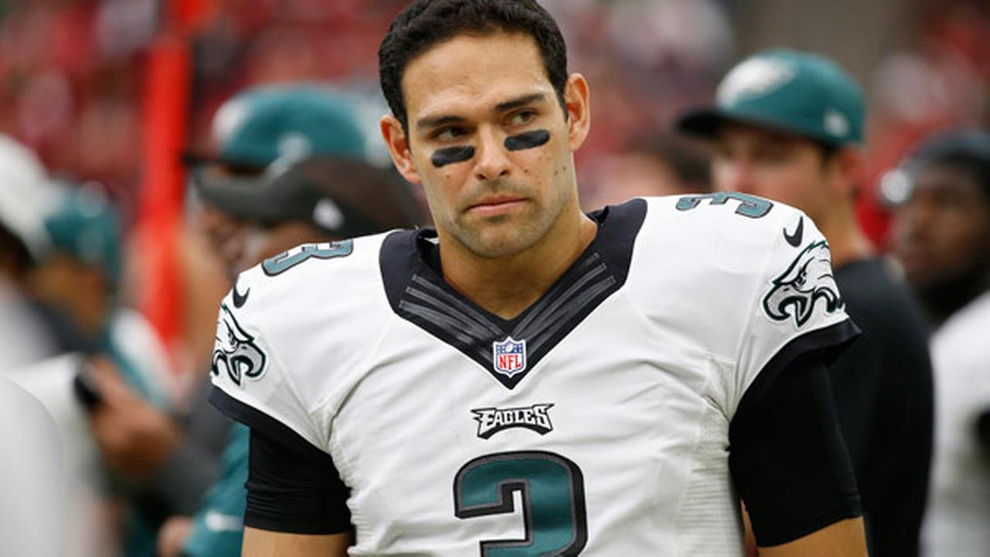
Our Hypotheses…We had two! (One came later...)
Twitter sentiment of auto-manufacturers is correlated with stock price fluctuation.
As more data is ingested, the accuracy of both our twitter sentiment model and our regression model will improve.
To put this in NFL terms… instead of ... (this season) or better yet (over time)..

Slide 6
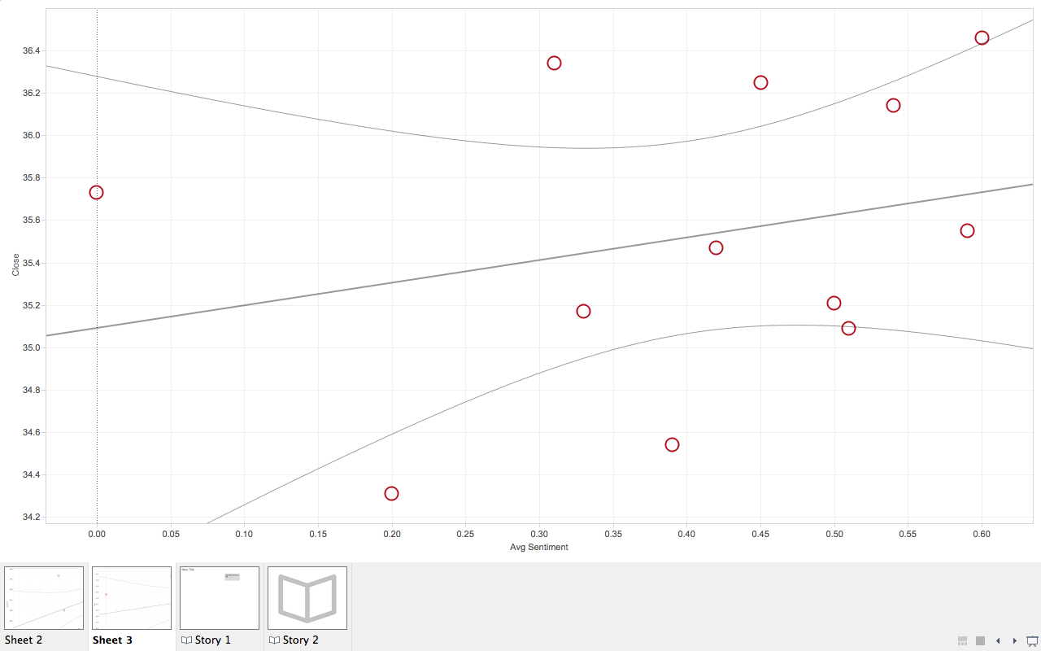
General Motors
Close Price ($)
Average Twitter Sentiment

Slide 7
Results
All else equal:
1% increase in Average Twitter Sentiment will increase the company's Stock Price by 1.23%
1% increase in Total Retweets will increase the company's Stock Price by 0.085%

Slide 8
Pipeline

Slide 9







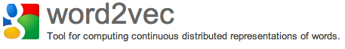


Data Science Pipeline - Tools
Data Ingestion
Data Munging
& Wrangling
Computation
and Analyses
Reporting
& Visualization
Modeling
& Application

Slide 10


Ingestion Module
Tweepy
Pymongo
NLTK
Data Wrangling Module
Regression Visualization
MatPlot Lib
Univariate Regressions
Twitter Sentiment Analysis.py
Twitter Sentiment Analysis

Slide 11

Sentiment Analysis (+1, -1)
Sentiment Visualization
Sentiment
Scores
Model (Multi-Variate Regression)
Model (Regression)
Model (Regression)
Fiat Stock Price
Results Visualization
Results Visualization
Results Visualization

Slide 12
Twitter Sentiment Analysis

Slide 13
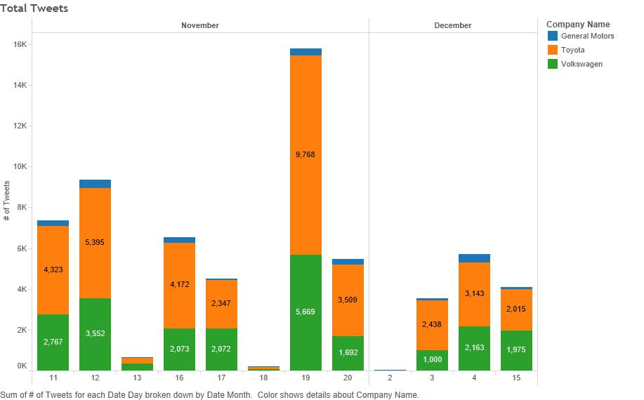
Tweets per Day

Slide 14
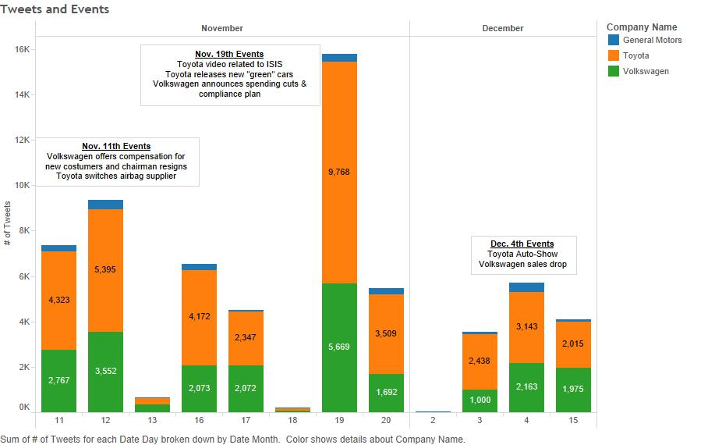
Events affecting sentiment

Slide 15
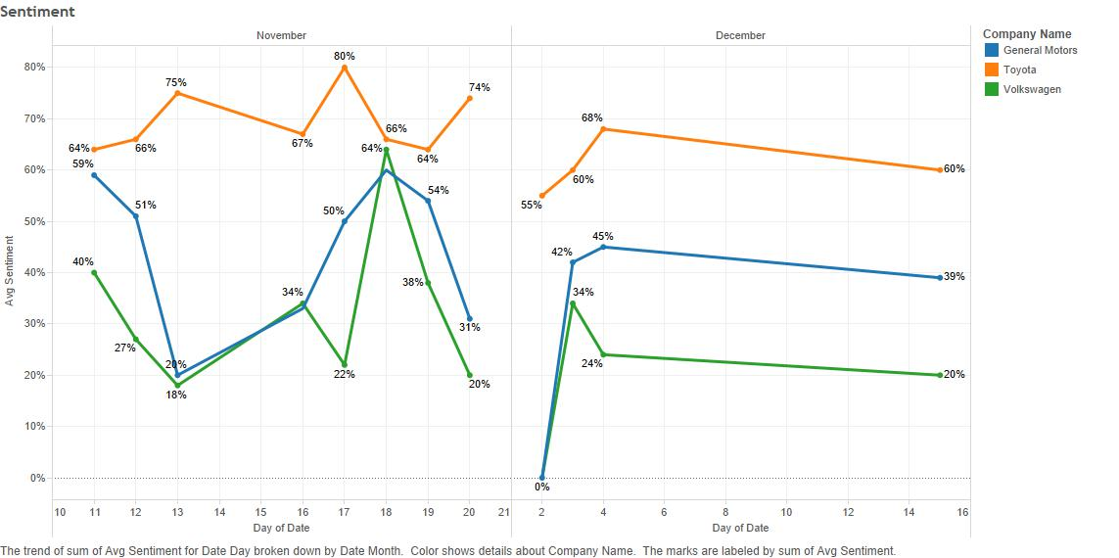
Twitter Sentiment by Day

Slide 16
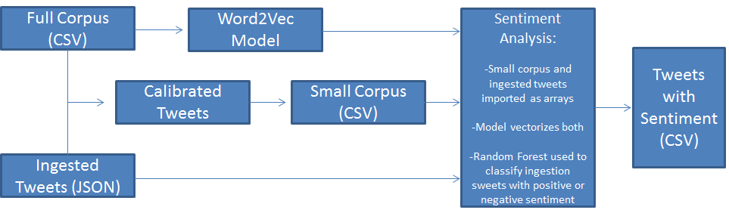
Sentiment Model

Slide 17

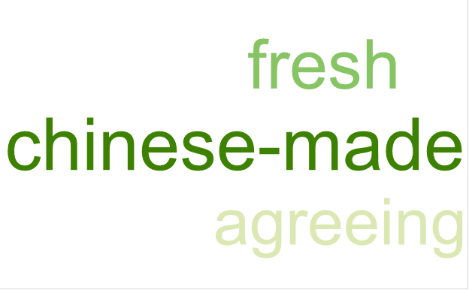
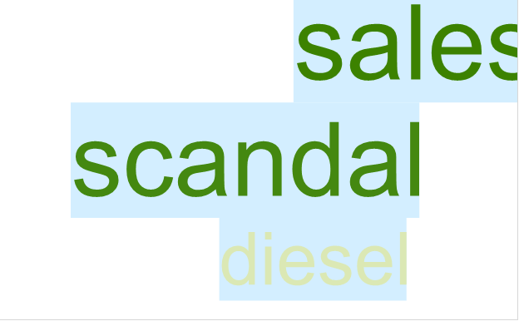
Most popular words on tweet-heavy days
Toyota, November 19
GM, November 12
Volkswagen, Dec 4

Slide 18
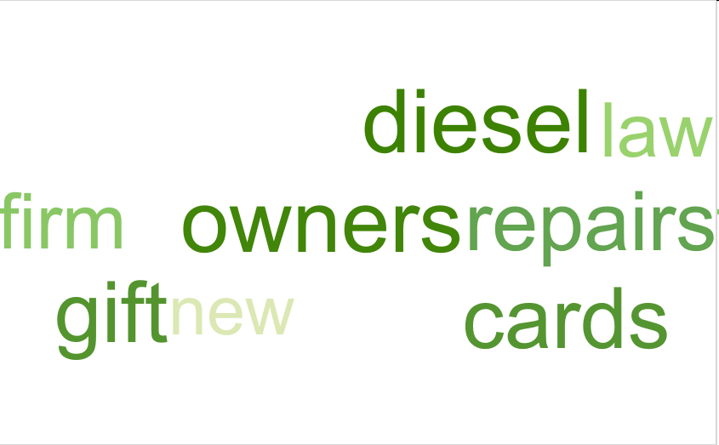
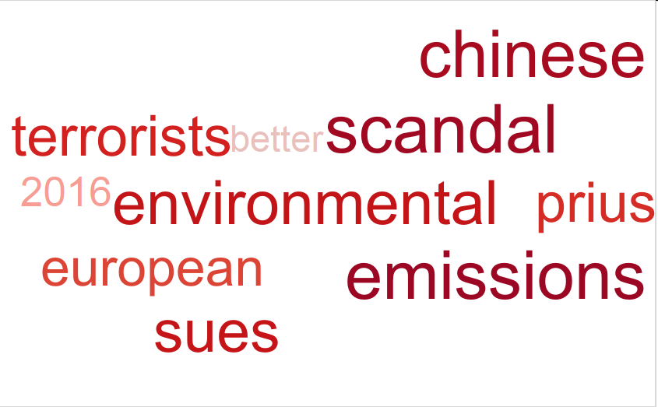
Good Days, Bad Days
Nov 18
Highest Sentiment Score
Dec 15
Lowest Sentiment Score

Slide 19
Word2Vec Word Associations
Some of the words from the previous slide, with word vectors that Word2Vec considers related.
Law: [(history, 0.5390466), (spanish, 0.5021017), (bible, 0.4971169)]
Chinese: [(thai, 0.5960268), (yummy, 0.5862064), (food, 0.5802457)]
Terrorists: [(delivers, 0.6527901), (#liesgirlstell, 0.6494534), (abortion, 0.6427389), (brutality, 0.6450986)]
Sues: [(emissions, 0.8482231), (scandal, 0.8285488), (whistleblower, 0.7530708), (volkswagen, 0.8451427)]
Repairs: [(brakes, 0.6788374), (mot, 0.6754294), (components, 0.6592078), (payments, 0.6592078)]

Slide 20
Regression Analysis

Slide 21
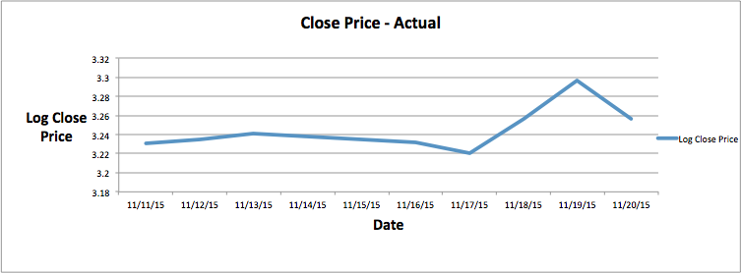
Sentiment Model vs Random Walk
Volkswagen

Slide 22
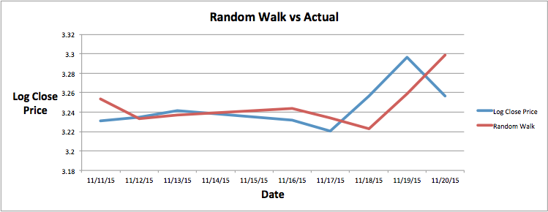
Sentiment Model vs Random Walk
Volkswagen

Slide 23
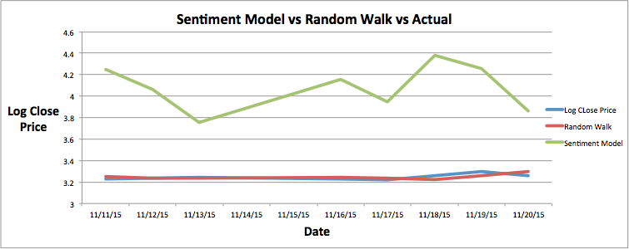
Sentiment Model vs Random Walk
Volkswagen

Slide 24
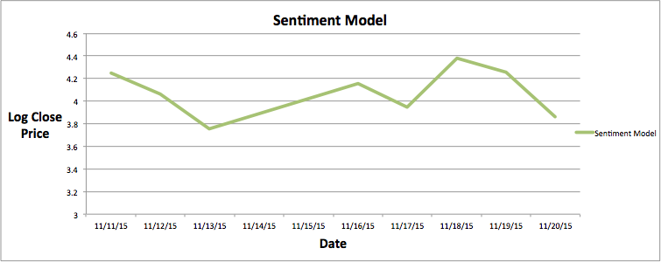
Sentiment Model vs Random Walk
Volkswagen

Slide 25
Accuracy Measures

Slide 26
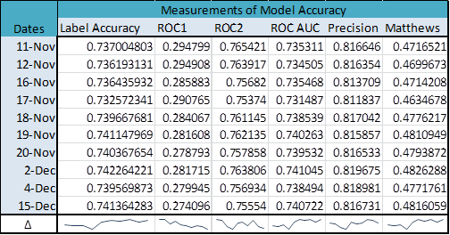
Increase in Accuracy of Twitter Model
Improvement in accuracy for all metrics
True positives significantly outnumber false positives; the model classification is superior to random classification
Matthews correlation coefficient is measured on a scale of -1 to 1, with 0 indicating random prediction and 1 being positive prediction
Note: the precision curve, which measures ability to avoid false positives, shows a decrease on the last day compared to improvements in the other metrics. Taken alongside the decreasing ROC2 (true positive) score, this suggests a possible issue with sentiment classification for terms used or introduced in December.

Slide 27
Conclusion

Slide 28
What we Learned!
Text Mining is HARD!
Twitter has limits to the amount of historical data that can be obtained on Twitter for free.
It is possible to find no correlation between the two at all – in that case, the model needs to be adjusted.
Looking at additional big data, like Google trends and Google search, might provide additional insight into behaviors of stock market.

Slide 29
Questions?

Slide 30
Back-up Slides

Slide 31
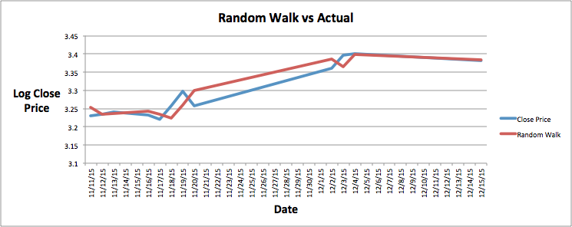
Sentiment Model vs Random Walk
Volkswagen

Slide 32
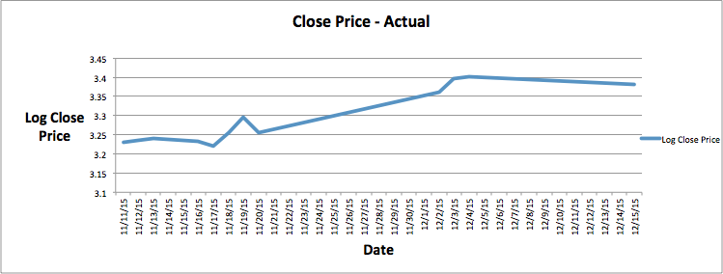
Sentiment Model vs Random Walk
Volkswagen

Slide 33
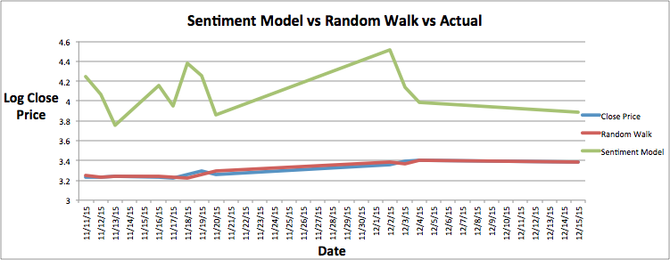
Sentiment Model vs Random Walk
Volkswagen

